Slide 1
Assignment 1
Smear Detection
Group members
Venkata Akshith Reddy Kasireddy (A20455209)
Sai Vishal Kodimela (A20453006)
Nikhil Sarika (A20470289)
Souporno Ghosh (A20439047)

Slide 2
Introduction
The smear that was detected on the camera lens by the photographers not only causes irritation but also provides hindrance to computer vision and digital forensics.
Therefore, it is very important to preprocess the picture by removing the smear from the pictures, which makes detection the first task.
Smear will cause camera to defocus and make these areas low-frequency.

Slide 3
Background
Smear will blur some areas in the picture, the defocus blur for lens dirties so large that the artifacts are always presented as a low frequency pattern in images.
Smear is almost fixed on camera, so the amount of scattered light is fixed since the integral of the outside illumination is unchanged.
An intermediate cause by smear between the target scene and the camera lens affects the image irradiance in two ways:
Attenuation - Where the scene radiance is reduced by absorption.
Intensification - Where the intermediate layer itself will contribute some radiance to the image sensor by scattering the light from other directions.

Slide 4
Approach
Calculated the average of images for each camera.
Thresholding the images at 100
Making an assumption, that central part of the image which is horizontal will contain only road patterns, we exclude that horizontal part from the mask.
Include everything in the mask
Dilate the mask using a kernel of 5x5

Slide 5
Results
Average of all images for the cameras

Slide 6

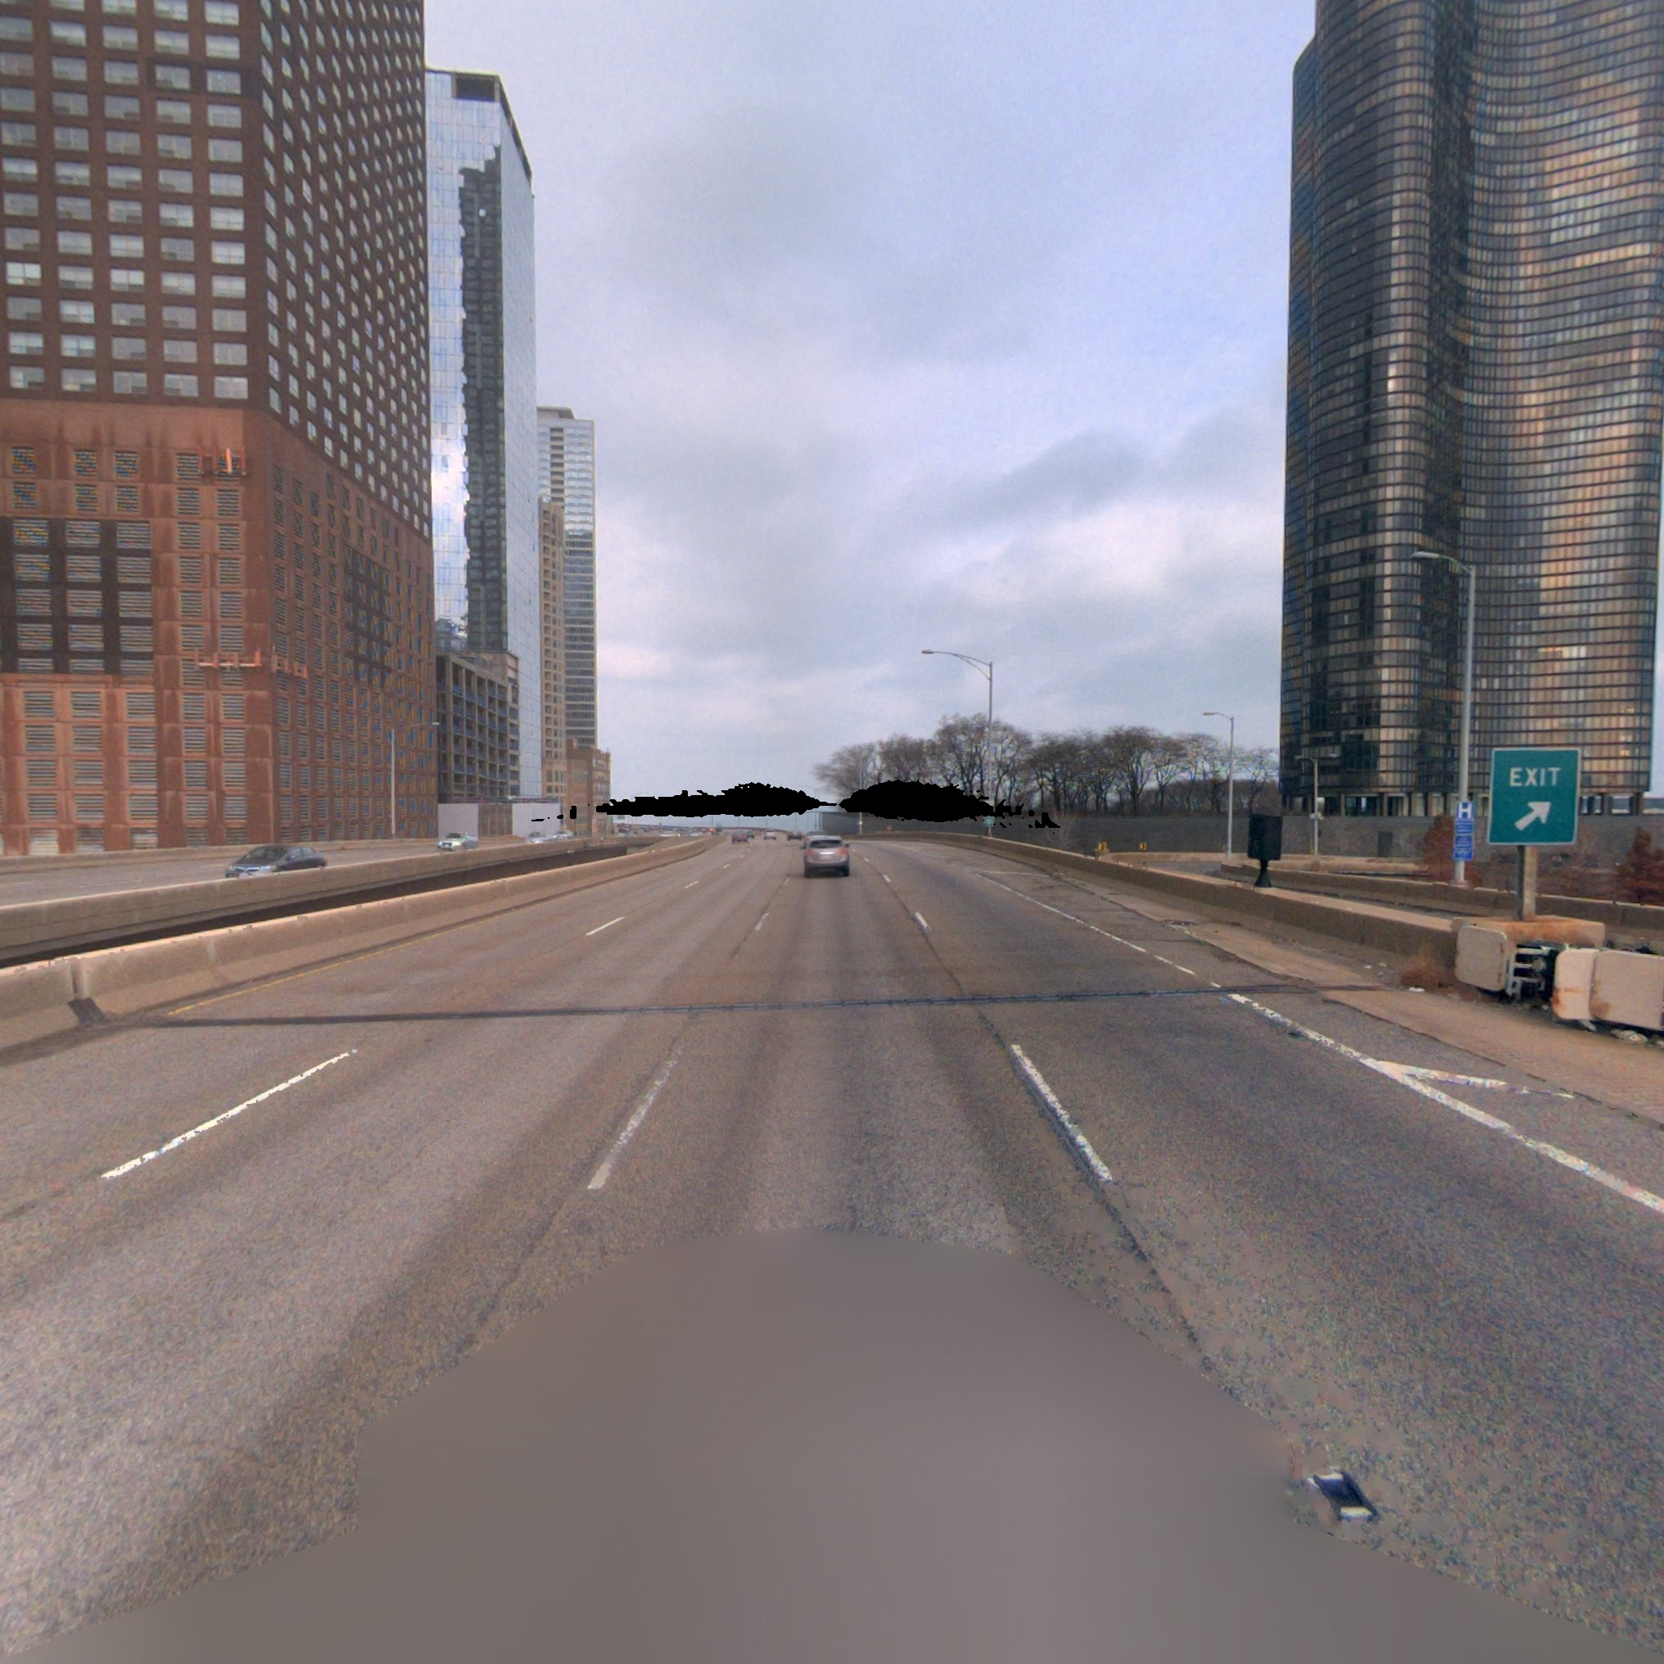
Cam_0
Shape of smear mask in cam_0

Slide 7

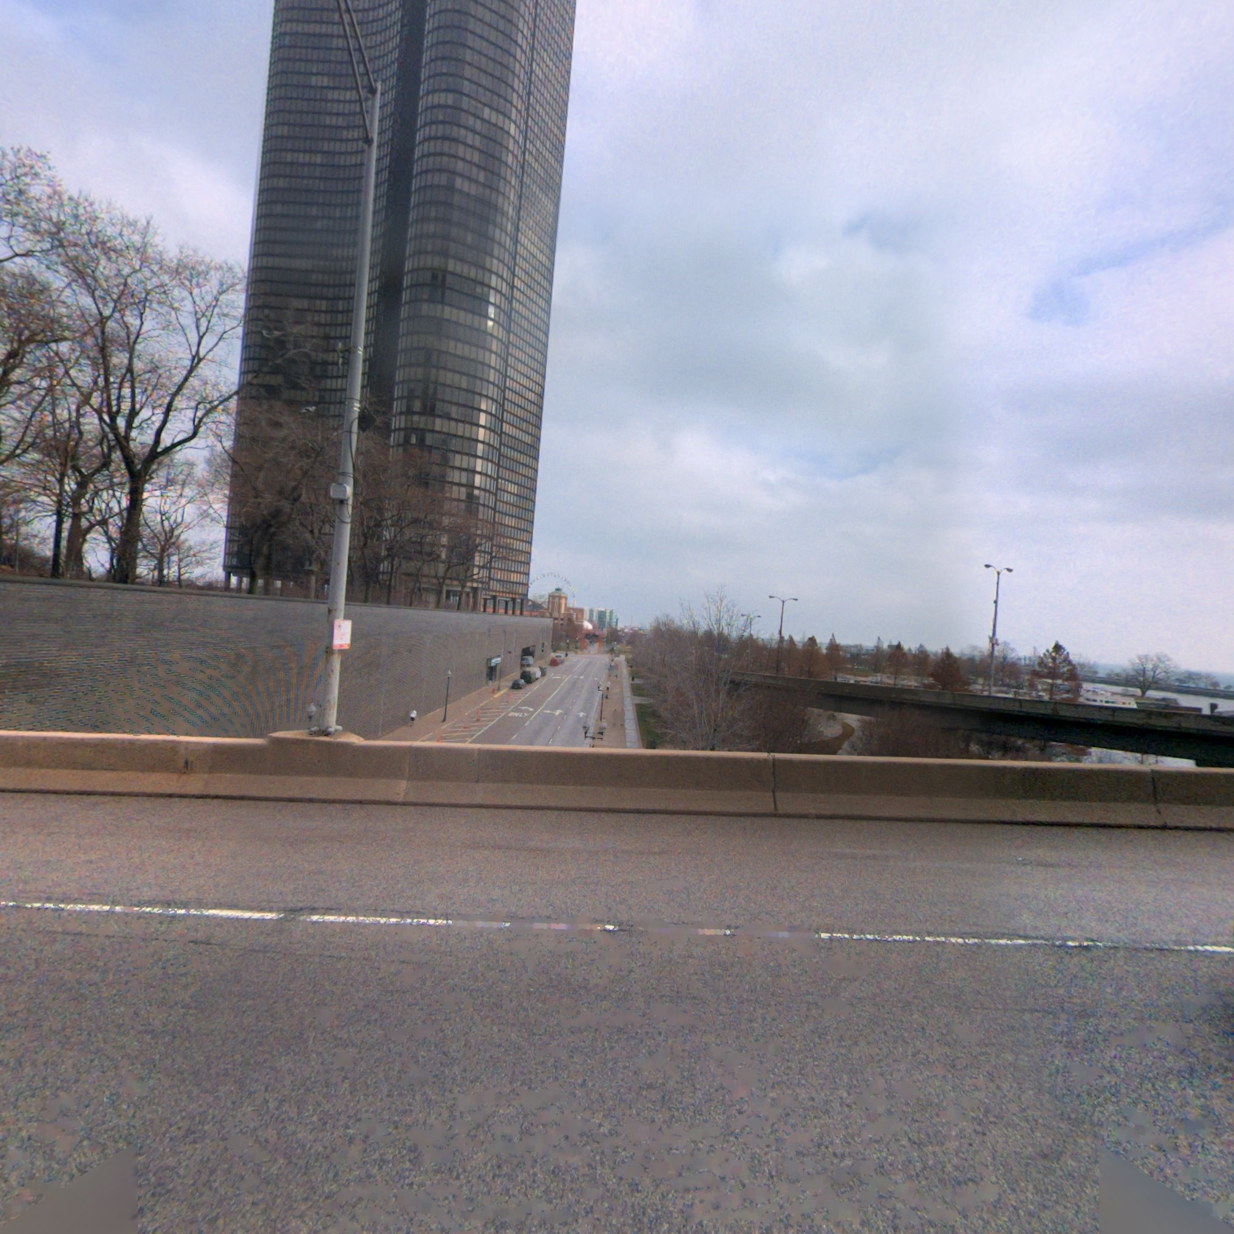
Cam_1
No smear mask detected in cam_1

Slide 8

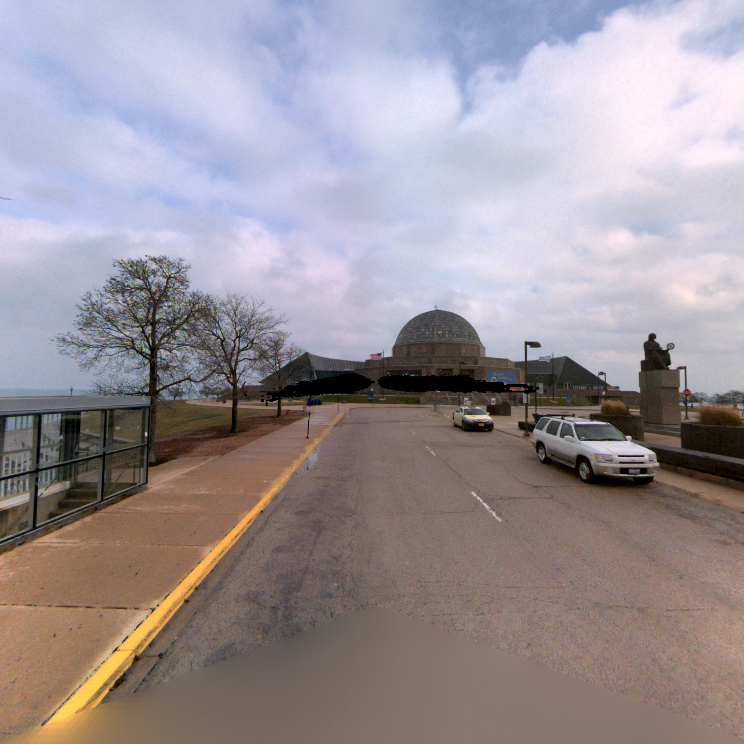
Cam_2
Shape of smear mask in cam_2
Shape of smear mask in cam_0

Slide 9

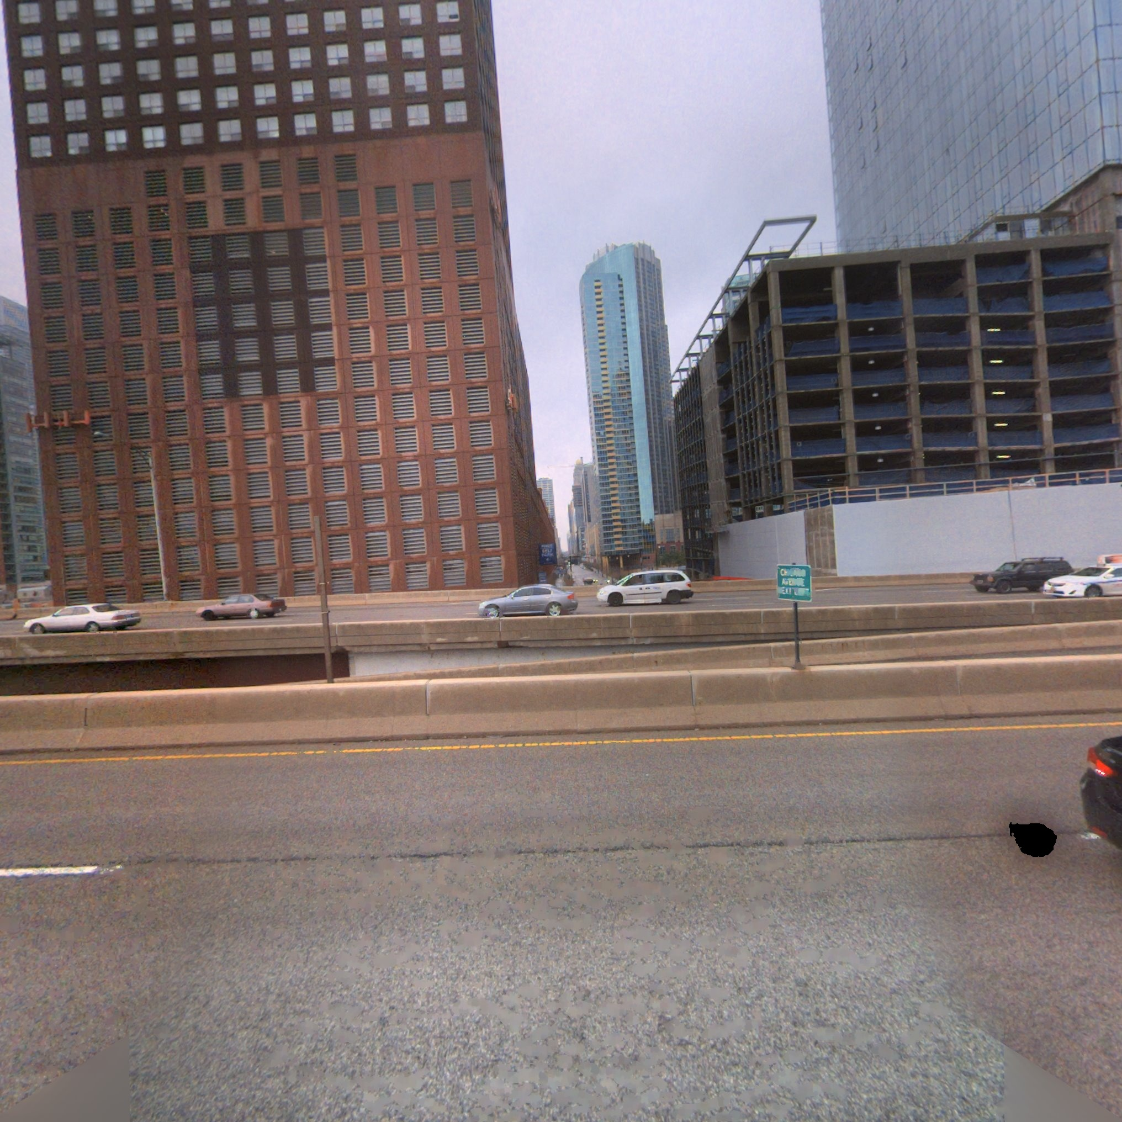
Cam_3
Shape of smear mask in cam_3

Slide 10
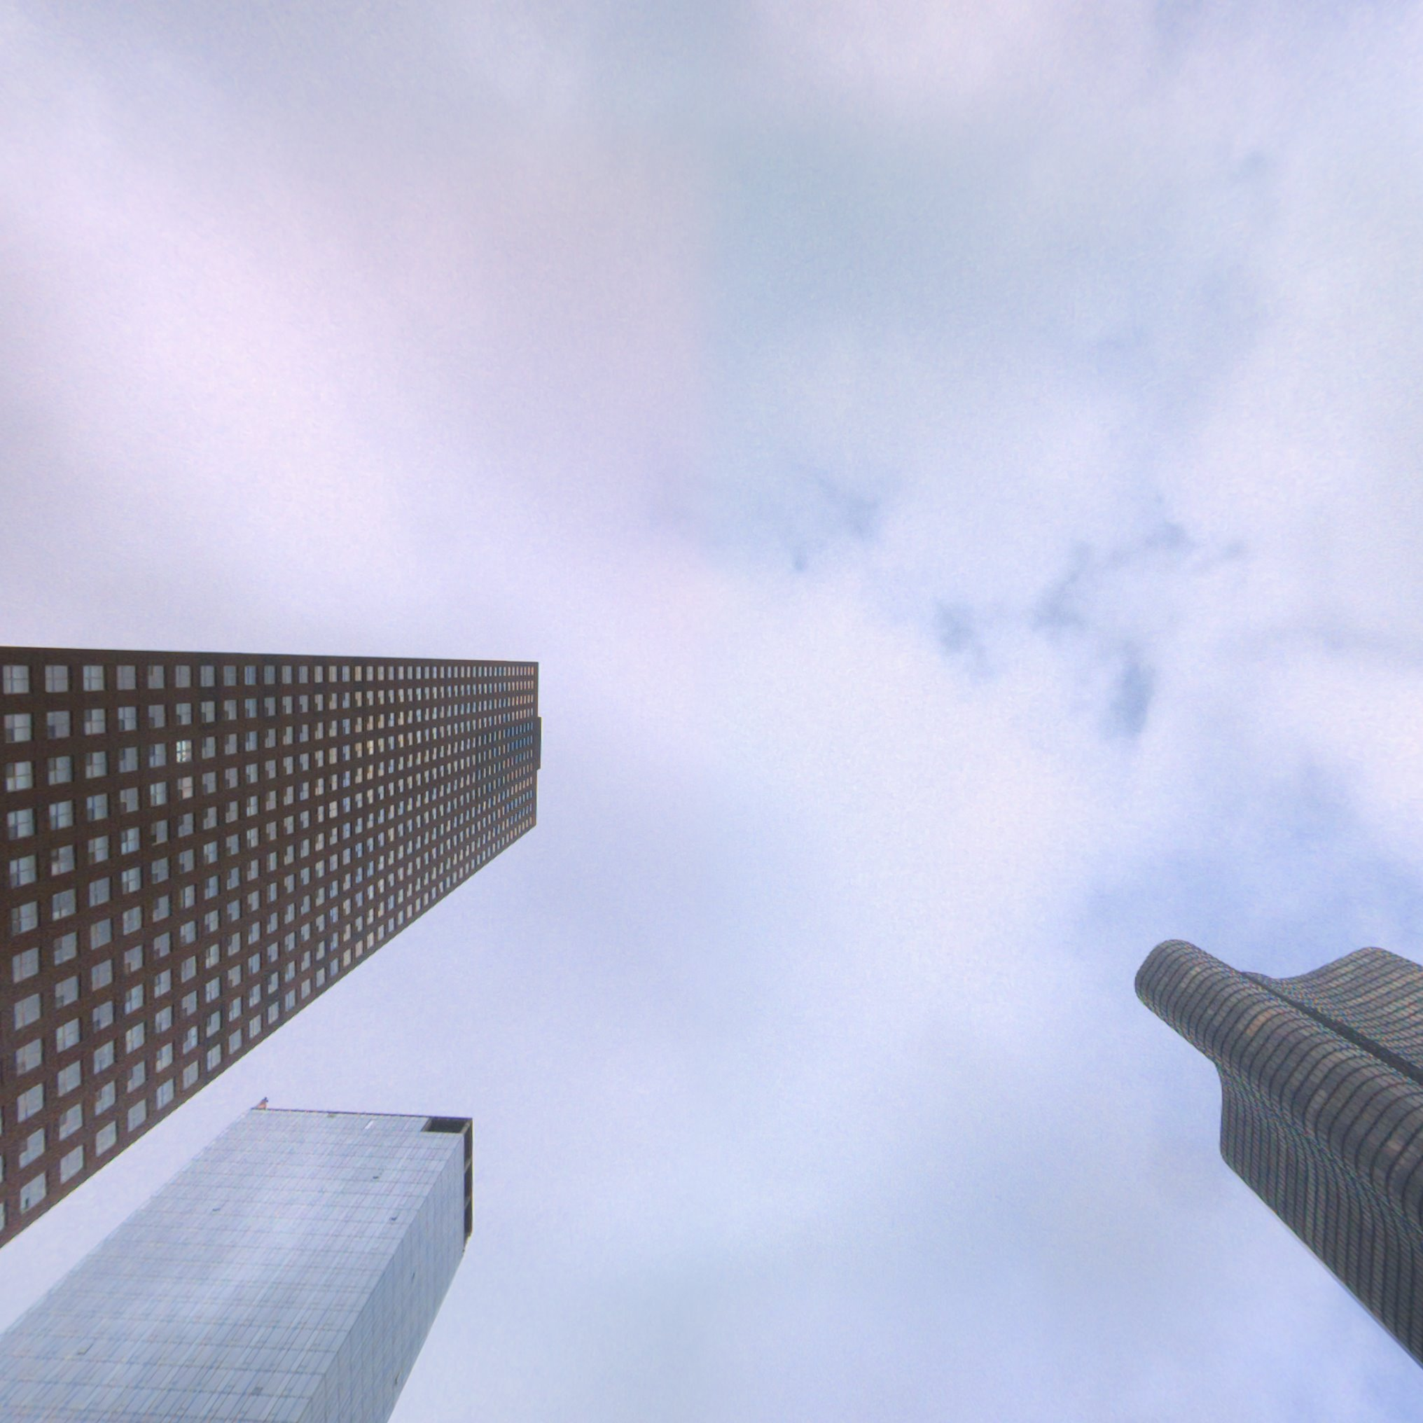
Cam_4
No smear mask detected in cam_4

Slide 11
Conclusion
One of the drawback which can be sorted out in future is that, the smear will only be detected if it absorbs light, for example dirt on the lens, etc.

Slide 12
THANKS!

